Slide 1

 | BMS INSTITUTE OF TECHNOLOGY & MANAGEMENT, YELAHANKA, BANGALORE. Department of Artificial Intelligence and Machine Learning
DataCleaner for Non-Image Datasets
ARAVIND SURESH
M S KAUSHIK
MANISH A S
SANDEEP AROCKIA SAMRAJ X
UNDER THE GUIDANCE OF:
Dr.Rajesh I S
Assistant Professor, AI&ML
BMSIT&M
2022-23

Slide 2
CONTENT
Introduction
Problem Statement
Objective
Limitations of Existing Systems
Research Gap and Research Challenges
Proposed Methodology
Implementation
Results
Conclusion and Future Work
Subject Mapping
References

Slide 3
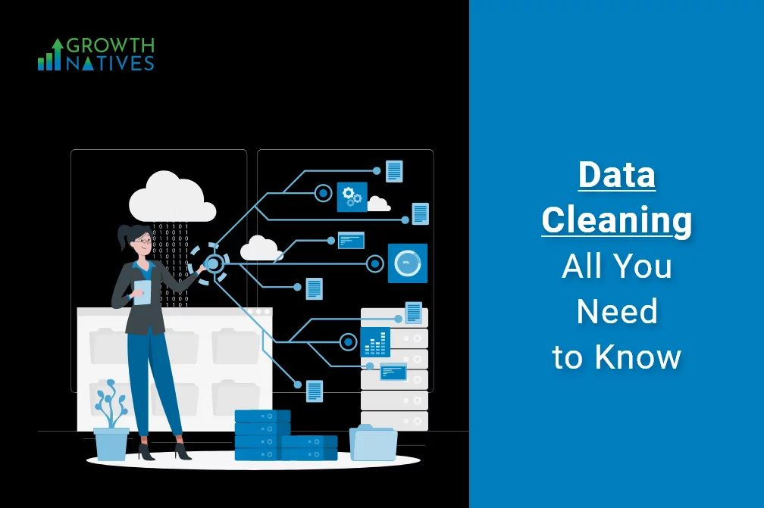

Slide 4
INTRODUCTION
Data cleaning is part of data preprocessing.It deals with detecting and removing errors and inconsistencies from data in order to improve quality of data.
In recent years, data science, artificial intelligence and machine learning domains are the new trend in IT industries. These domains are mainly dependent on datasets and these datasets must be cleaned in order to arrive at accurate results.

Slide 5
INTRODUCTION(CONTD)
The project deals with cleaning of data by removing the unnecessary features in the dataset and filling the missing values. It also has the option to provide the metrics of the dataset for a particular machine learning algorithm model.

Slide 6
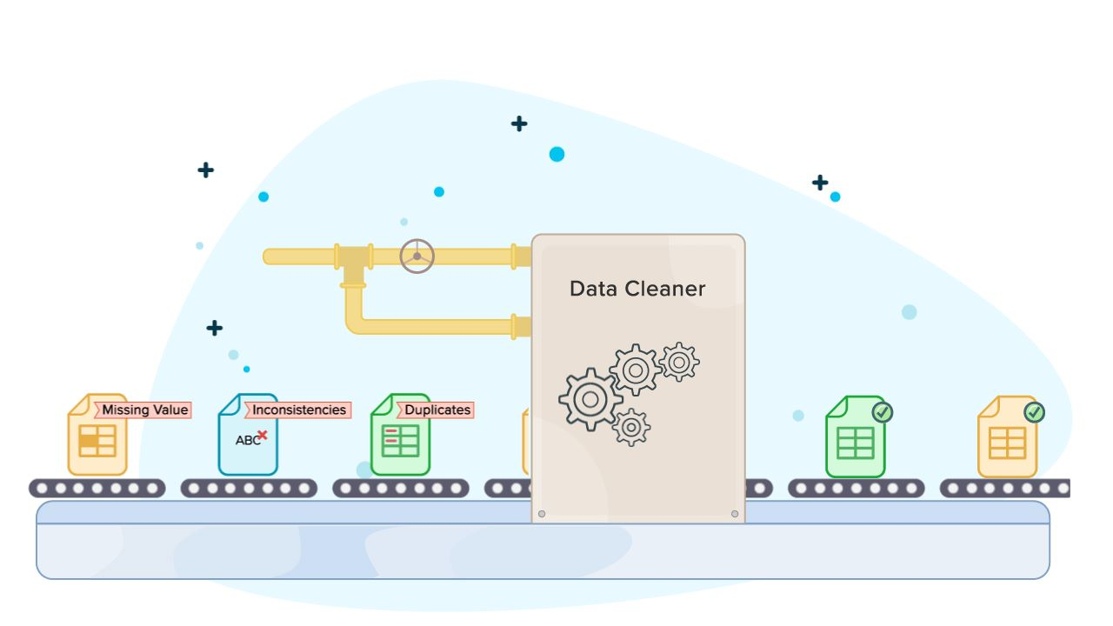

Slide 7
PROBLEM STATEMENT
Cleaning a dataset is time consuming and only small datasets can be cleaned manually.

Slide 8
OBJECTIVE
This project aims to reduce the time to clean the dataset.
Also to provide a general idea on how good the dataset is for a particular machine learning algorithm.
To improve the quality of the dataset.

Slide 9
LIMITATIONS OF EXISTING SYSTEM
It consumes more time.
Doesn’t remove the unnecessary features.
Manually cleaning the values of datasets may lead to removal of necessary data.

Slide 10
RESEARCH GAP AND CHALLENGES
Automatic cleaning of dataset.
From the papers we have read, we noticed that implementation of data cleaning was not automatic. And was time consuming.

Slide 11
PROPOSED METHODOLOGY
The frontend of the website is created using ReactJS and for backend Python (Flask) is used.
To clean the dataset:
1.Missing values are removed.
2.Structural errors are fixed.
3.Duplicate values are removed.
4.Textual values are encoded.
5.Feature selection is performed.
6.Outliers are removed.

Slide 12
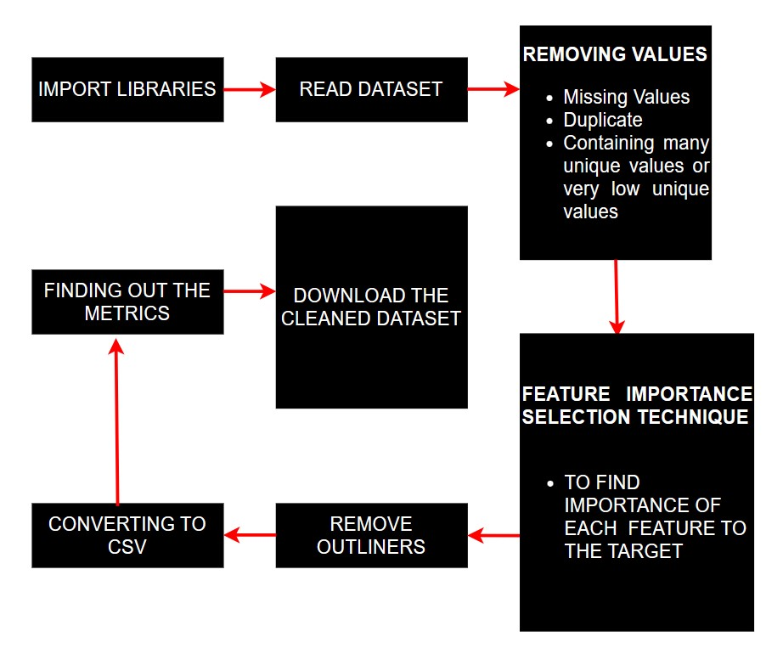
PROPOSED METHODOLOGY(CONTD)
LIERS
Fig. 1

Slide 13
IMPLEMENTATION
We are using Python(FLASK) and React Js for implementing this project :
Python:
Python is an interpreted, object-oriented, high-level programming language. Its high-level built in data structures, combined with dynamic typing.
Flask is a web framework, it’s a Python module that lets you develop web applications easily.
REACT JS:
ReactJS is a declarative, efficient, and flexible JavaScript library for building reusable UI components. It is an open-source, component-based front end library which is responsible only for the view layer of the application. It was initially developed and maintained by Facebook and later used in its products like WhatsApp & Instagram.

Slide 14
IMPLEMENTATION(CONTD)
To implement the process of automated cleaning of dataset,The following steps are performed:
1.Removing missing values: First the columns with multiple null values are removed.Then the rows with null values are removed.
2.Removing duplicates: The rows which are repeated are deleted.
3.Uniques columns: The columns with multiple unique values as well as the columns with very few unique values are removed.

Slide 15
IMPLEMENTATION(CONTD)
4.Feature importance: First the textual data is converted into
numbers using Integer Encoding.
Feature importance of each feature is found by using ExtraTreesClassifier. Then the columns with lesser importance is removed.
5.Remove Outliers:Outliers in the dataset is removed using the z-score.

Slide 16
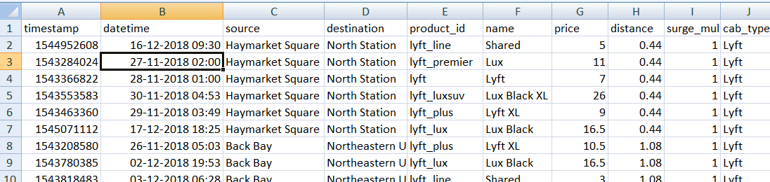
RESULTS
(693071, 57)
(627648, 10)
r2_score after cleaning: 0.815029960

Slide 17
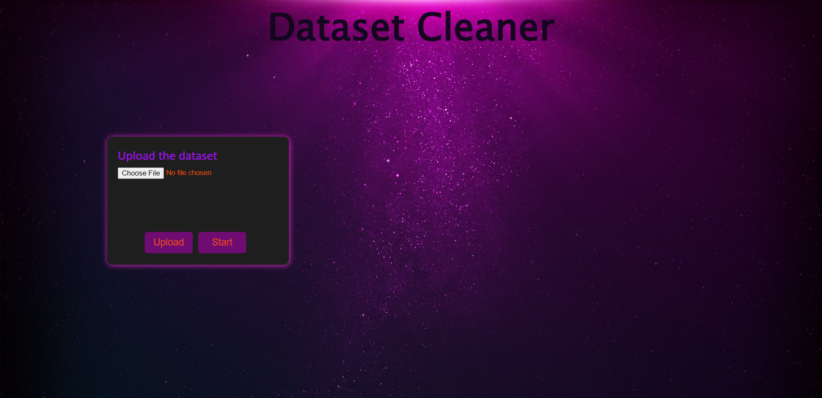
SNIPPET OF THE WEBSITE

Slide 18
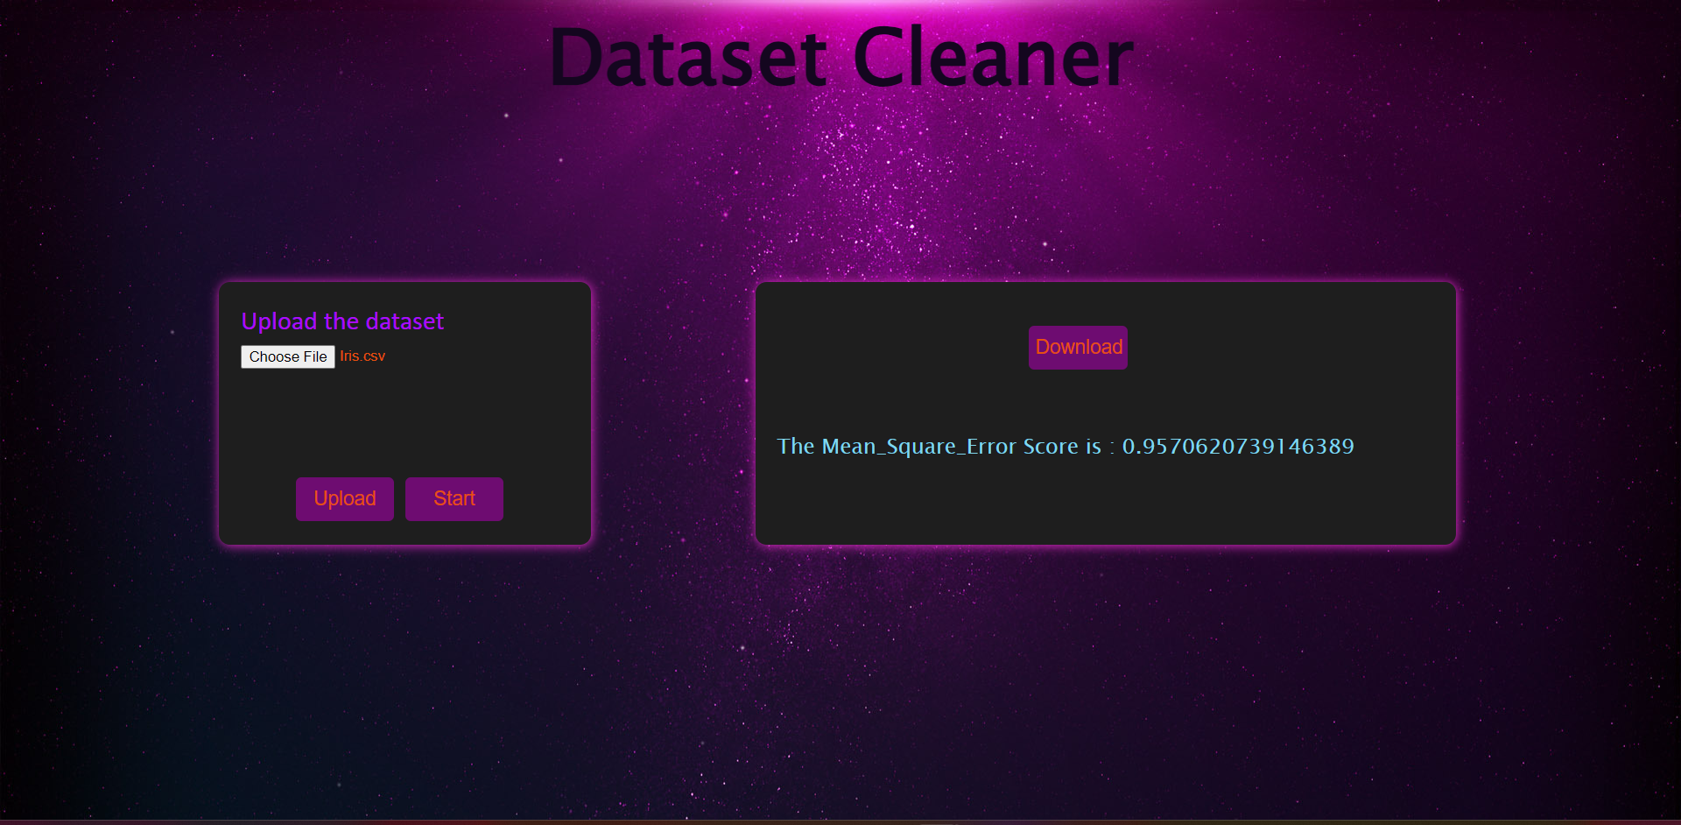

Slide 19
CONCLUSION AND FUTURE WORK
We conclude that we accomplished our objectives by reducing the time to clean the dataset and improving the quality of dataset with max r2_score possible.
The limitations of our project will be our challenge as the future work. They are:
Website cannot handle heavy datasets.
Low webpage security.

Slide 20
SUBJECT MAPPING
Machine Learning (18AI61) - We use sklearn methods to filter the required features and machine learning algorithms to build a model and calculate the metrics.

Slide 21
REFERENCES
1.Jesmeen, M.Z.H., Hossen, J., Sayeed, S., Ho, C.K., Tawsif, K., Rahman, A. and Arif, E., 2018. A survey on cleaning dirty data using machine learning paradigm for big data analytics. Indonesian Journal of Electrical Engineering and Computer Science, 10(3), pp.1234-1243.
2.Neutatz, F., Chen, B., Abedjan, Z. and Wu, E., 2021. From Cleaning before ML to Cleaning for ML. IEEE Data Eng. Bull., 44(1), pp.24-41.
3.Ga Young Lee, Lubna Alzamil, Bakhtiyar Doskenov, Arash Termehchy
Cite As: arXiv:2109.07127 [cs.DB]
4.Mahdavi, M., Neutatz, F., Visengeriyeva, L. and Abedjan, Z., 2019. Towards automated data cleaning workflows. Machine Learning, 15, p.16.
5.Corrales, D.C., Corrales, J.C. and Ledezma, A., 2018. How to address the data quality issues in regression models: a guided process for data cleaning. Symmetry, 10(4), p.99.

Slide 22


